Slide 1
Introduction to Structural Competency
Socrative: tami101
For TUCCOM c/o 2020 on August 4, 2017
By Matthew Musselman OMS III

Slide 2
Vocabulary Check... What are we talking about?
Need a “shared language” to identify how structures affect health
Notes:
Note:

Slide 3
Cultural Competency
Cross cultural communication = important
Competency implies an endpoint
INCOMPETENT
COMPETENT
Notes:
Every patient encounter is a cross-cultural encounter (Hendriksz et al)

Slide 4
Cultural Competency
a trend in medical education, and seeks to “counteract the marginalization of patients by race, ethnicity, social class religion, sexual orientation, or other markers of difference“
by emphasizing a patient-centered approach that takes into account “culturally specific sources of stigma”
Cultural Competency does not address “the complex relationships between clinical symptoms and social, political, and economic systems.”
Notes:
Quote from Metzl, J. & Hansen, H. (2014). Structural competency: theorizing a new medical engagement with stigma and inequality. Social Science & Medicine, 103, pp. 126-133.
Every patient encounter is a cross-cultural encounter (Hendriksz et al)

Slide 5
Interpersonally…
“Sit down.”
“Be humble.”
Embrace Cultural Humility.
Further Reading on this topic:
Tervalon, M. & Murray-Garcia, J. (1998). Cultural humility versus cultural competence: a critical distinction in defining physician training outcomes in multicultural education. Journal of Health Care for the Poor and Underserved, 9(2), pp 117-25. Link.
https://en.wikipedia.org/wiki/Cultural_humility good old Wikipedia...
Notes:
Every patient encounter is a cross-cultural encounter (Hendriksz et al)
Lifelong self-reflexion & learning.

Slide 6
What is Structural Competency?
Beyond interpersonal interactions
The capacity for health professionals to recognize and respond to health and illness as the downstream effects of social, political, and economic structures. (taken from Josh Neff)
Notes:
YOU ARE THE EXPERTS, NOT ME

Slide 7
Structural Competency
A way of thinking
Safe-Space. No Grade. No “Right Answers”
Student-Driven part of the Curriculum at Touro ? HMU!
Sitting & Doing
Further Reading on this topic:
Metzl, J. & Hansen, H. (2014). Structural competency: theorizing a new medical engagement with stigma and inequality. Social Science & Medicine, 103, pp. 126-133. LINK.
Pigg, S.L. (2013). On sitting and doing: ethnography as action in global health. Soc Sci Med, 99, pp. 127-134. LINK.
Notes:
YOU ARE THE EXPERTS
“Our hope is that you will try to sit with the discomfort through this process of participating in structural competency—there will not always be clear answers or solutions, but know that you can learn from the questions as well as the uncertainty.” (OHSU)

Slide 8
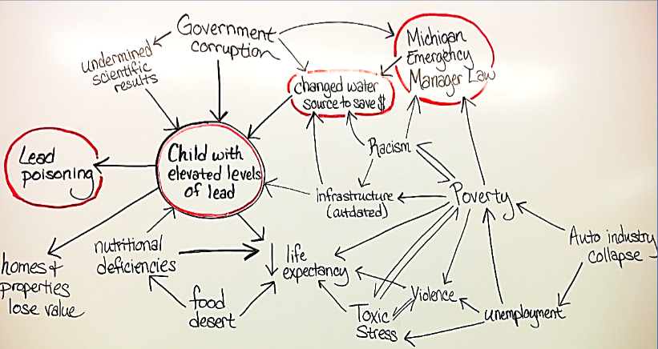
Structural Competency EXAMPLE
A 7 year-old girl in Flint, Michigan is found to have elevated lead levels by her pediatrician.
What factors contributed to the outcome of high lead levels in children?
Thanks, OHSU !
Notes:
YOU ARE THE EXPERTS
“Our hope is that you will try to sit with the discomfort through this process of participating in structural competency—there will not always be clear answers or solutions, but know that you can learn from the questions as well as the uncertainty.” (OHSU)

Slide 9
What is Racism?
PARTNER UP
And answer in Socrative: tami101

Slide 10
OUR FIRST PATIENT CASE.
Zea Malawa, MD

Slide 11
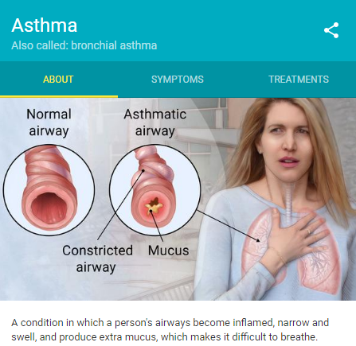
You are a Family Physician or Pediatrician in the Bay Area
5 y/o male PMH asthma presents for SOB
Third time coming in with this complaint
Previously given SABA, then low-dose ICS. Temporary improvement only.
You Rx medium-dose ICS + LABA & refer to Pulmonology
➔ What may be going on STRUCTURALLY to cause our patient to have this problem? *discuss while answering on Socrative
Notes:
Skeleton … DISCUSS !
END by 30 minutes.

Slide 12
Meet “Ben”
Ben is a 6 yr old African American boy
Ben lives in the Bayview area of SF with his parents and grandmother
Ben’s family is very worried because Ben has asthma which has been hard to control
Every 3 months, Ben’s mother misses work to take him to the pulmonologist. On the bus, it takes 1.5 hours in either direction to get there.

Slide 13
I was calling to let you know that I have admitted your patient Ben for an asthma exacerbation…
His parents did not pick up his controller med refill last week and he’s missed a lot of school recently because of wheezing.
His father was arrested last month for drugs!
I called CPS. These parents need to learn to get serious about their son’s health.

Slide 14
What if the pulmonologist knew…
I cannot afford to pick up his refill until I get paid next week.
Median incomes for Blacks in San Francisco is $27,000 compared with $89,000 for Whites, a disparity twice as large as the national average.
(New York Times, 2016)

Slide 15
The Bayview district has more Black residents than any other SF neighborhood.
(City-data.com)
Because of it’s proximity to freeways and industrial sites, it has the highest concentration of air and surface pollutants in SF.
(Environmental Defense Scorecard, 2005)
I usually give him his medicine everyday but he still can’t stop wheezing.

Slide 16
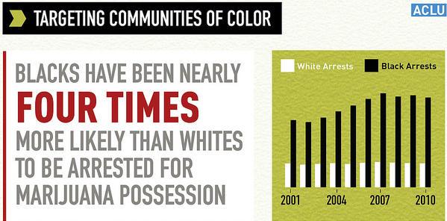
His father just had a little weed in his pocket. The police are always harassing us.

Slide 17
I cannot believe that doctor called CPS on us. I don’t want to bring my son to her any more.
Black children are 3 times more likely to enter foster care compared to white families with the same characteristics.
Families of color receive fewer services than White families do and experience lower rates of reunification.
(Annie E Casey Foundation. Report: Race Matters: Unequal Opportunity within the Child Welfare System, 2006)
Notes:
But how could the pulmonologist know? We don’t talk much about racism in medical school…
An the end result is that many people of color have poor health outcomes.

Slide 18
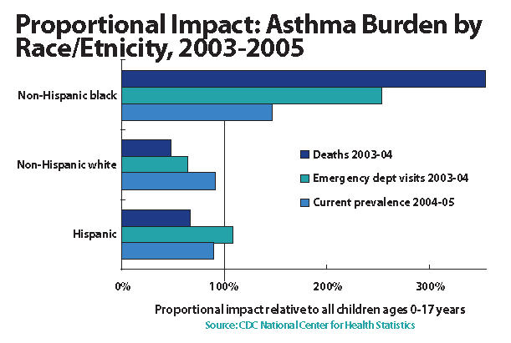
Notes:
I witnessed this type of exchanges so many times during my practice. These statistics do not surprise me. Asthma is only one of MANY conditions where there are pronounced racial health disparities.

Slide 19
Has racism affected Ben’s health?
PARTNER UP
And answer in Socrative: tami101

Slide 20
From the New England Journal of Medicine
“…even as research on health disparities has helped to document persistent gaps in morbidity and mortality between racial and ethnic groups, there is often a reluctance to address the role of racism in driving these gaps.
A search for articles published in the Journal over the past decade, for example, reveals that although more than 300 focused on health disparities, only 14 contained the word “racism” (and half of those were book reviews)…”

Slide 21
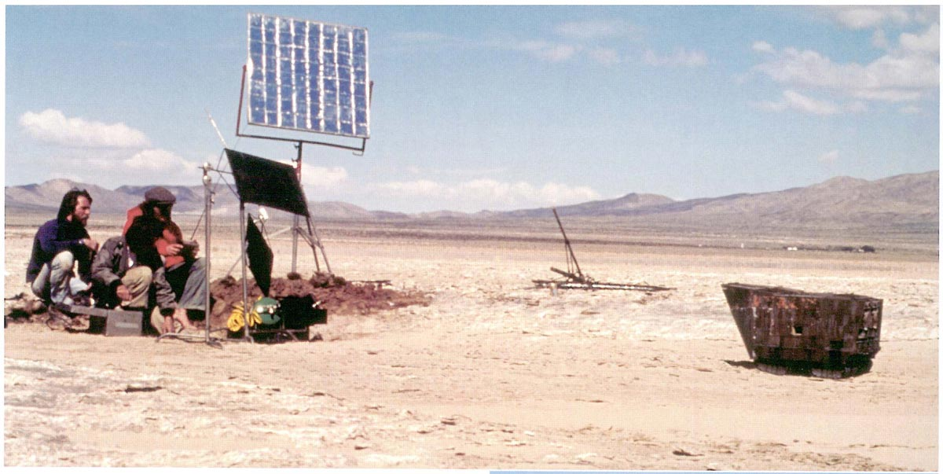
Notes:
Set of Star Wars: A New Hope

Slide 22
Racism 101—What Is Racism?
A system

Slide 23
Racism 101—What Is Racism
A system of structuring opportunity and assigning value

Slide 24
Racism 101—What Is Racism
A system of structuring opportunity and assigning value based on the social interpretation of how we look (“race”)
Further Reading: Coates, T. (2013, May 15). What we mean when we say ‘race is a social construct.’ The Atlantic. LINK.

Slide 25
Racism 101—What Is Racism
A system of structuring opportunity and assigning value based on the social interpretation of how we look (“race”)
Unfairly disadvantages some individuals and communities

Slide 26
Racism 101—What Is Racism
A system of structuring opportunity and assigning value based on the social interpretation of how we look (“race”)
Unfairly disadvantages some individuals and communities
Unfairly advantages other individuals and communities

Slide 27
Racism 101—What Is Racism
A system of structuring opportunity and assigning value based on the social interpretation of how we look (“race”)
Unfairly disadvantages some individuals and communities
Unfairly advantages other individuals and communities
Saps the strength of the entire society through the waste of human resources
Source: Jones, CP (2003)

Slide 28
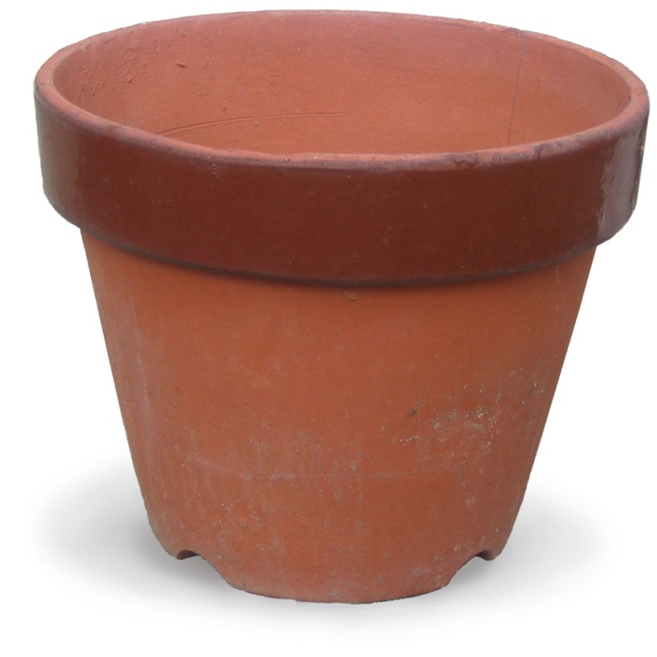
Racism 101—The Gardeners Tale

Slide 29
Racism 101—The Gardeners Tale
Short video (2 min)
Medium video (20 min)
Long video (64 min)
Article (OG)

Slide 30
Racism is a Public Health Crisis
Race is a distinct construct from racism.
USA is a racially stratified society¹
→ Being Black vs Being Black in America
Privilege Exists²
Further Reading on this topic:
García, J.J. & Sharif, M.Z. (2015). Black lives matter: a commentary on racism and public health. Am J Public Health, 105, pp. e27-e30. LINK.
Campos, P.F. (2017, July 29). White economic privilege is alive and well. New York Times. LINK.
Gladwell, M. BLINK. Chapter 3: The Warren Harding Error. LINK (to reading guide).

Slide 31
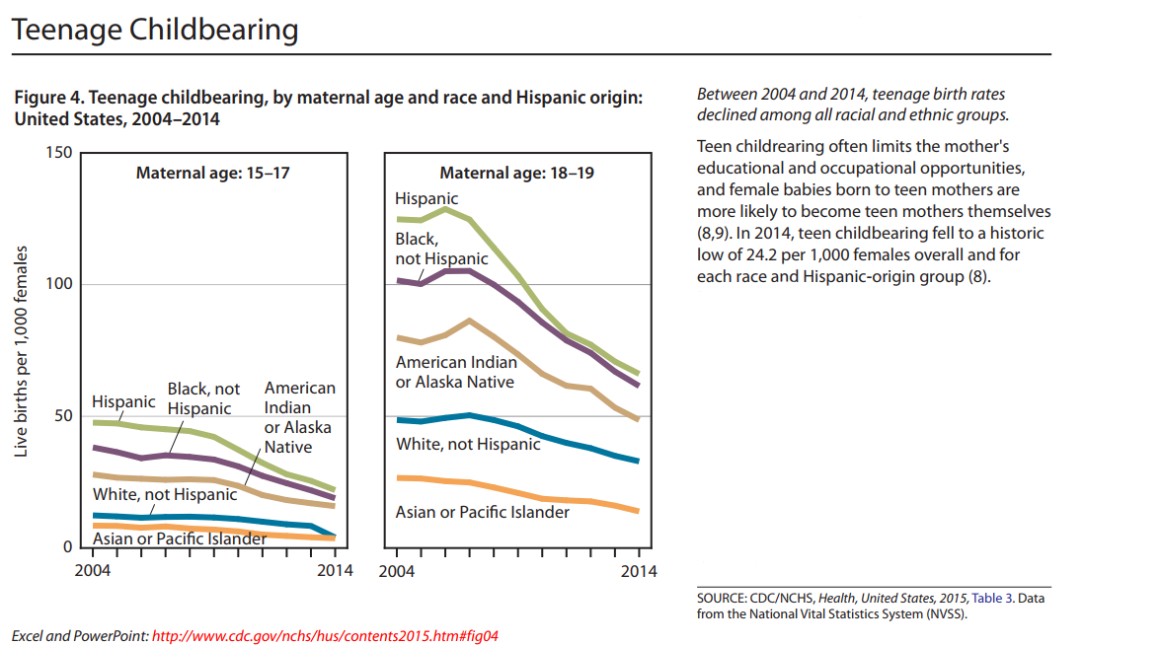
Racism → Racialized Health Disparities
1. CDC. (2017). Health, United States, 2015 with special features on racial and ethnic health disparities. Page 28. LINK (PDF).
2. Paradies et al. (2015). Racism as a determinant of health: a systematic review and meta-analysis. PLOS ONE. LINK.

Slide 32
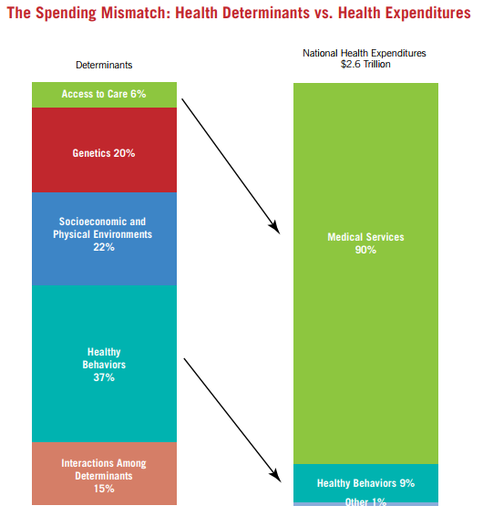
Racism is Structural
Beyond interpersonal
aggression
Beyond any particular
incident or example
Boston Foundation. (2014). Healthy People / Healthy Economy Annual Report Card. LINK.

Slide 33
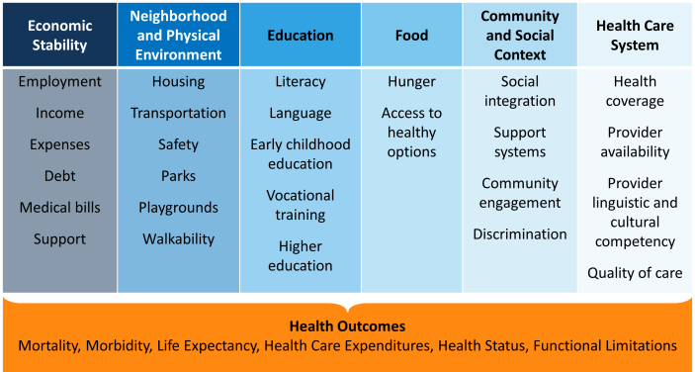
Evaluate Structural Vulnerability
How do the Social Determinants of Health affect your patient?
Heiman, H.J. (2015). Beyond health care: the role of social determinants in promoting health and health equity. Kaiser Family Foundation - Disparities Policy. LINK.

Slide 34
Bourgois, P., Holmes, S.M., Sue, K. & Quesada, J. (2017). Structural vulnerability: operationalizing the concept to address health disparities in clinical care. Academic Medicine, 92(3), pp. 299-307. LINK.

Slide 35
thanks ← Lola
Notes:
Lola

