Slide 1
Beyond Micro-Aggressions
An exploration of a compensatory code

Slide 2
What are Microaggressions?
https://www.youtube.com/watch?v=BJL2P0JsAS4

Slide 3
Learning Objectives
Understand that racism, sexism and homophobia do not have to be intentional
Provide examples of the different (types of) microaggressions
Develop tools to recognize and respond to microaggression

Slide 4
Unconscious Bias
Information highway
Schema.
Structural oppression.
Notes:
Our brain allows us to process 400 billion bits of information a second.
However, we are consciously aware of 2k
Dr. Joseph Dispenza

Slide 5
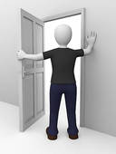
Talk it out
What are the biases that you have recognized within yourself?
How does diversity impact the production/performance of bias?
How does bias produce microaggressions?
Notes:
What are your biases? What biases have you noticed from those around you?

Slide 6
Microaggressions in the Classroom
https://www.youtube.com/watch?v=ZahtlxW2CIQ

Slide 7
Micro-Aggressions
Microinvalidation
interactions that exclude, negate or minimize the experiences and feelings of marginalized people.
Micro-insult
Interactions that demean persons from marginalized communities.
Micro-assault
Explicit and intentional derogation intended to do emotional and/or psychological harm
Sue et. al. 2007

Slide 8
Microaggression: Logic
Anyone can make it if they try.
Can’t you just do what we do behind closed doors?
You are your own worst enemy
I do not see race. I see human beings
Myth of meritocracy
Normalizing cis gender identity and Heteronormativity
Recognizing culture/behavior as pathological
Assuming that difference is the root of racism rather than white supremacy
Notes:
Hand out the examples of microaggressions as the video plays and have a discussion about them.

Slide 9
Microaggressions: Decoded
“Where are you from?”
“You are so articulate!”
I don’t see race
Can I help you find something?
You can also choose to be straight?
You clearly were not born here and are not an “authentic American”
People like you typically don’t sound that smart
I would rather deny my complicity with racial oppression than accept that racism shapes your lived experience
People like you are prone to steal. My question signifies that you are under my surveillance
My imposition of heteronormativity is an attempt to deny the validity of your sexuality

Slide 10
Microaggression: Intervention
“Where are you from?”
“You are so articulate!”
“I am colorblind.”
“Can I help you find something?”
Have you ever tried to be with a person of the opposite assigned sex at birth?
“I’m not racist! I have black friends.”
I’m just curious…what makes you ask that?
Why shouldn’t they/I be?
Does that make you blind to race and racism?
Yes. I would like to know why you are not as helpful to your white customers?
Have you?
Your statement lets me know more about your Black friends than you?

Slide 11
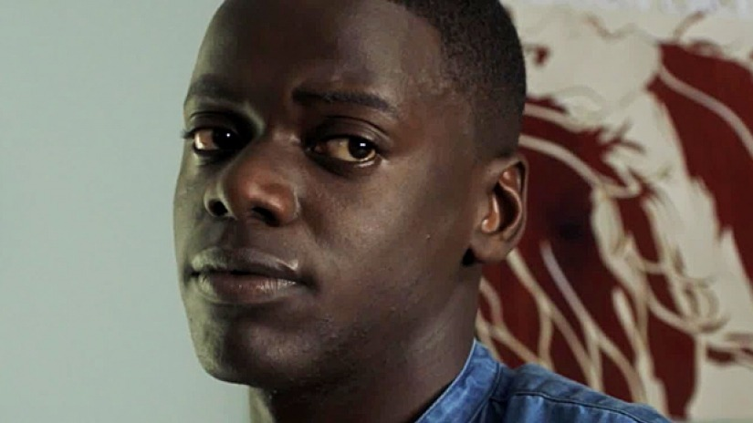
Conflict Resolution 4Ds
1.Direct – Confront the situation
2.Delay – Check in later with those who were involved
3.Delegate – Collaborate intervention strategy
4.Distract – Create a diversion to interrupt the situation

Slide 12
Personal Inventory
Recognize your own personal biases, what triggers them and work to diffuse your personal triggers
Dedicate class/meeting time to talk about colorblind racism/genderblind sexism
Create a syllabus/policy clause that provides examples of microaggressions/bias and opportunities for advocacy.
Use your and vicarious experiences to create more workshops similar to this one.
Co-create workshops/class assignments/activities that encourage people to confront race, gender, class and sexuality bias beyond talking points.
Work with scholars and practitioners to create certificate and/or web-based program.

